Slide 1
Flower Classification By Using KNN Algorithm
Presented by :
Muhammad Zubair Hasan (201714041)

Slide 2
What is KNN?
• A powerful classification algorithm used in pattern
recognition.
• K nearest neighbors stores all available cases and
classifies new cases based on a similarity measure(e.g
distance function)
• One of the top data mining algorithms used today.
• A non-parametric lazy learning algorithm (An Instance based
Learning method).

Slide 3
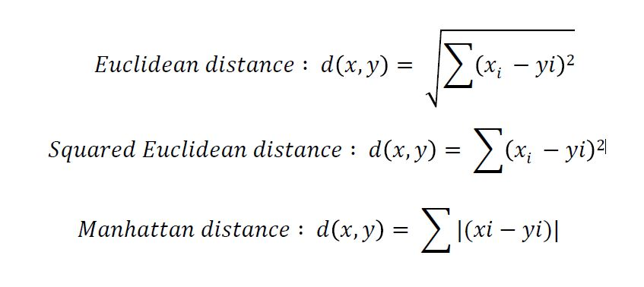
Distance Measure

Slide 4
KNN Classifier Algorithm

Slide 5
How to choose K?
If infinite number of samples available, the larger is k, the better is classification. Also k is always assumed odd to break the tie in classification.
k = 1 is often used for efficiency, but sensitive to “noise”

Slide 6
When k=3 or k=5??

Slide 7
Larger k gives smoother boundaries, better for generalization,
but only if locality is preserved. Locality is not preserved if we end
up looking at samples too far away, not from the same class.
Generally for simplicity k <= sqrt(n) where n is # of examples and k is odd. But with cross validation technique best k value can be found.

Slide 8
IRIS Dataset
First introduced in 1936 by the famous statistician Ronald Fisher
It consists of 50 observations from each of three species of Iris (Iris setosa, Iris virginica and Iris versicolor).
Four features were measured from each sample: the length and the width of the sepals and petals.
My goal is to train the KNN algorithm to be able to distinguish the species from one another given the measurements of the 4 features.

Slide 9
Training Data (IRIS Dataset)
ID | SepalLengthCm | SepalWidthCm | PetalLengthCm | PetalWidthCm | Species
1 | 5.1 | 3.5 | 1.4 | 0.2 | Iris-setosa
2 | 4.9 | 3 | 1.4 | 0.2 | Iris-setosa
3 | 4.7 | 3.2 | 1.3 | 0.2 | Iris-setosa
51 | 7 | 3.2 | 4.7 | 1.4 | Iris-versicolor
52 | 6.4 | 3.2 | 4.5 | 1.5 | Iris-versicolor
53 | 6.9 | 3.1 | 4.9 | 1.5 | Iris-versicolor
101 | 6.3 | 3.3 | 6 | 2.5 | Iris-virginica
102 | 5.8 | 2.7 | 5.1 | 1.9 | Iris-virginica
103 | 7.1 | 3 | 5.9 | 2.1 | Iris-virginica

Slide 10
Test Data
Id | SepalLengthCm | SepalWidthCm | PetalLengthCm | PetalWidthCm
50 | 5 | 3.3 | 1.4 | 0.2
100 | 5.7 | 2.8 | 4.1 | 1.3
150 | 5.9 | 3 | 5.1 | 1.8

Slide 11
Technology
pandas
numpy
matplotlib
scipy
Sklearn
streamlit

Slide 12
Training Setup of KNN
Training Set = X_train = randomly selected 100 inputs
y_train = labels of training set
Test Set = X_test = Rest of the dataset
y_test = labels of the test set
Optimum k = 3

Slide 13
Classification With Neural Network
Structure :
Training Setup :
Batch size = 5
Epoch = 150
Loss_func = Sparse_crossentropy
Dense – 8
Activation = ReLu
Dense – 16
Activation = ReLu
Dense – 3
Activation = Softmax
Input (4 dim)
Output

Slide 14
Result
Model Name | Accuracy
KNN | 98%
Random Forest | 98.67%
Neural Network | 98.67%
Input ID | Model | Prediction | Ground Truth
50 | KNN | Iris-setosa | Iris-setosa
100 | Random Forest | Iris-versicolor | Iris-versicolor
150 | Neural Network | Iris-virginica | Iris-virginica

